Slide 1
Professional Article Writing and Publication in Impact Factor Journals
Dr. Ugochukwu Chinonso Okolie
Department of Vocational & Technical Education,
Alex Ekwueme Federal University, Ndufu-Alike

Slide 2
Why You Must Publish in High-Impact-Factor Journals
Increased Visibility and Prestige:
High-impact-factor journals have a wide readership, ensuring that research reaches a global audience.
Publishing in these journals enhances the researcher's recognition and credibility in their field.
Career Advancement and Professional Credibility
A strong publication record in reputable journals is a marker of scholarly achievement.
It can lead to career progression, academic promotions, and collaboration opportunities.

Slide 3
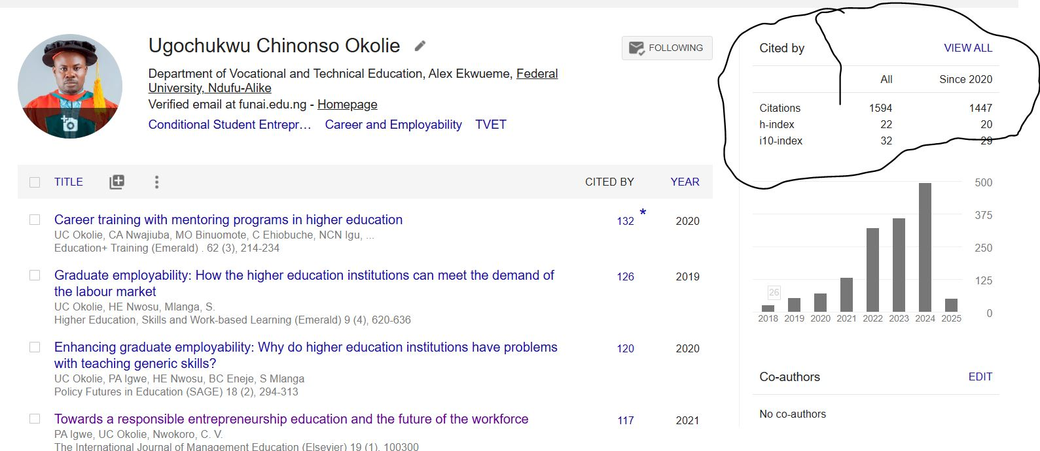
Higher Citation Rates
Articles in high-impact-factor journals are more likely to be cited due to their perceived quality, contributing to the researcher's academic impact and reputation.

Slide 4
Access to Research Funding
Funding agencies often prioritize researchers with publications in top-tier journals.
Strong publication records improve the chances of securing grants and financial support.
Rigorous Peer-Review Process
Expert reviews help refine and improve the quality of research.
Constructive feedback strengthens the validity and reliability of the study.

Slide 5
Salient Requirements for Publishing in High-Impact Factor Journals
High-Quality, Original Research
The study must present novel insights or significant advancements in the field.
It should address a critical gap in existing knowledge or provide innovative methodologies.
The research must be free from plagiarism and uphold ethical standards.

Slide 6
Strong Theoretical and Methodological Framework
A well-defined research question and hypothesis must be clearly articulated.
The study should follow a rigorous research design with appropriate methodology and analysis.
Results must be robust, replicable, and supported by solid statistical or qualitative evidence.

Slide 7
Clear and Coherent Writing
Manuscripts must be well-structured, with a clear abstract, introduction, methodology, results, discussion, and conclusion.
The language should be concise, precise, and free of grammatical errors.
Proper use of technical terms and discipline-specific jargon is essential while maintaining accessibility for a broad academic audience.

Slide 8
Adherence to Journal Guidelines
Each journal has specific submission guidelines, including formatting, referencing style, and word count.
Authors must ensure their manuscript aligns with the scope and aims of the journal.
Proper citation of previous literature and compliance with ethical considerations are mandatory.

Slide 9
Strong Theoretical and Empirical Contribution
High-impact-factor journals prefer research that challenges existing theories or proposes new perspectives.
The study should have real-world applications or policy implications that advance knowledge and practice in the field.
Rigorous Peer-Review Process
Submissions undergo multiple rounds of peer review, requiring authors to address reviewers' concerns effectively.
A well-structured response to reviewers' comments enhances the chances of acceptance.

Slide 10
Ethical and Transparent Research Practices
Authors must disclose conflicts of interest and adhere to ethical guidelines (e.g., informed consent, data privacy).
Data transparency and reproducibility are encouraged, with some journals requiring raw data availability.
High Citation Potential
Journals prioritize studies likely to attract citations and contribute to ongoing scholarly debates.
A strong literature review, discussion of findings, and implications for future research help enhance citation potential.

Slide 11
Please, Ask Your Questions

